Slide 1
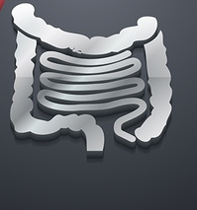
SMALL AND LARGE INTESTINE
Prof. Dr. Mazin A. Abdulla
Fourth Year

Slide 2
OBJECTIVES
To recall the surgical Anatomy of small & large bowel
Functional abnormalities
Megacolon and non-megacolon constipation
Structural anomalies
Angiodysplasia
Blind loop syndrome
small intestine and colonic diverticular diseases
Conclusion

Slide 3
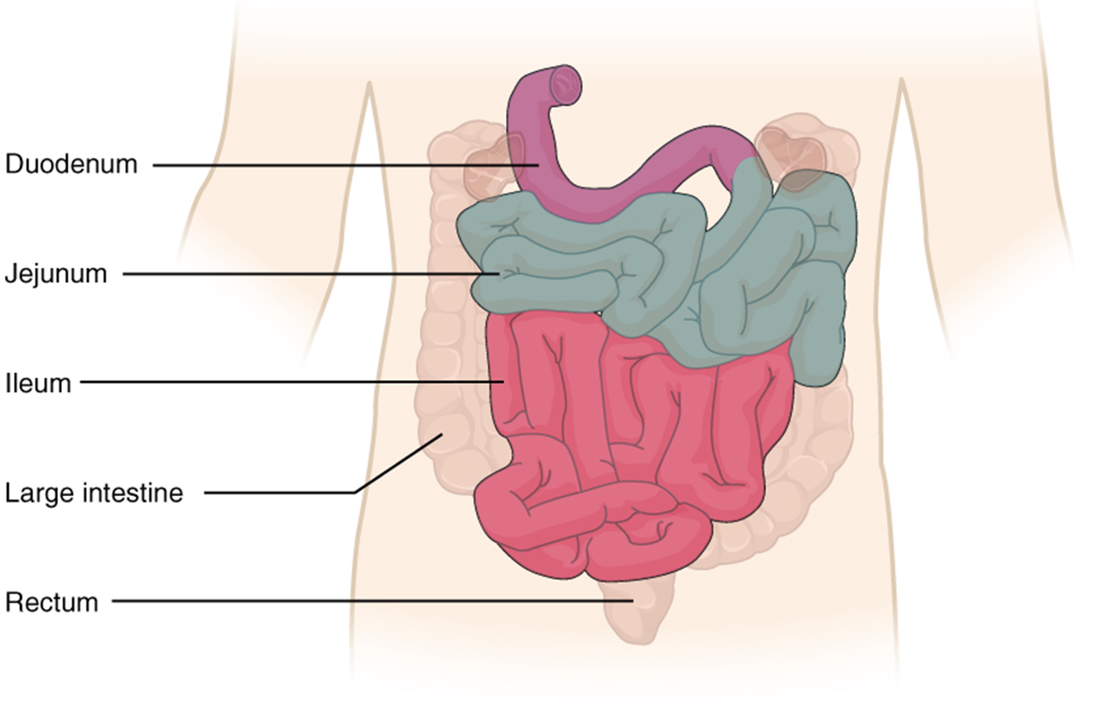
Small intestine
It is the longest part of alimentary tract (6 M)
Extends from pylorus of stomach to ileocecal junction
Diameter 4 cm at GD junct.
2.5 cm at IC junct.
It represents 75% of whole bowel
95% mucosal surface
It is attached to post. abdominal
wall by mesentery.

Slide 4
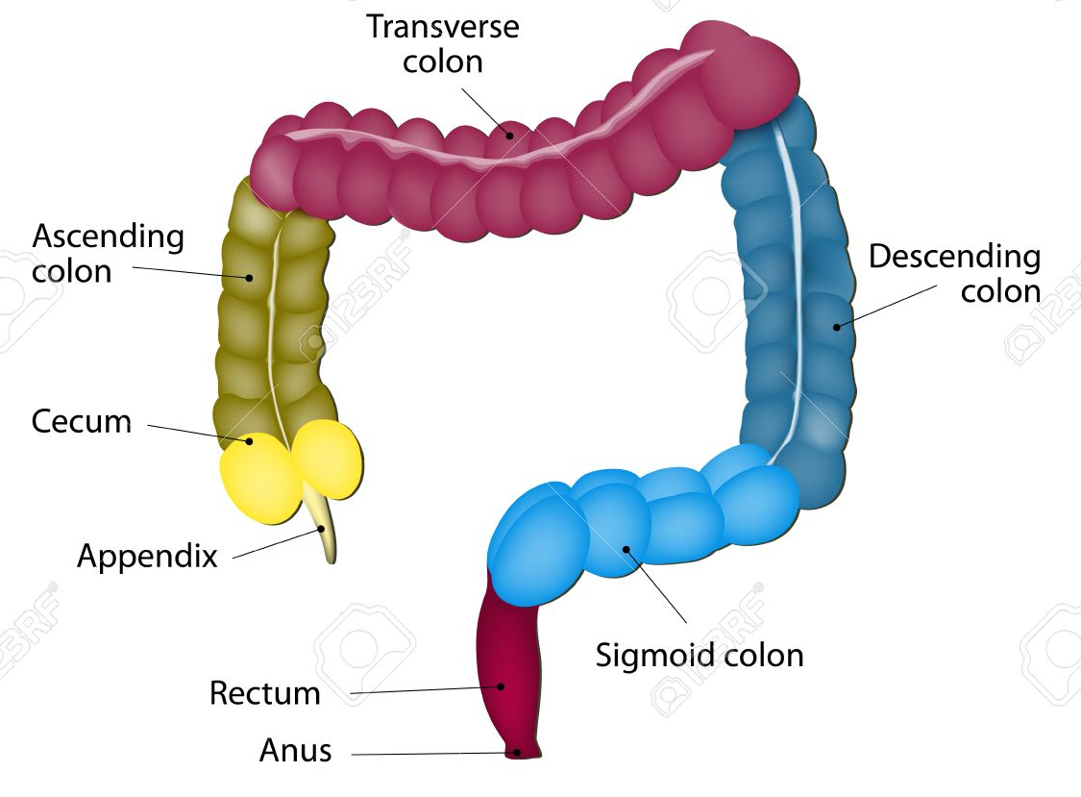
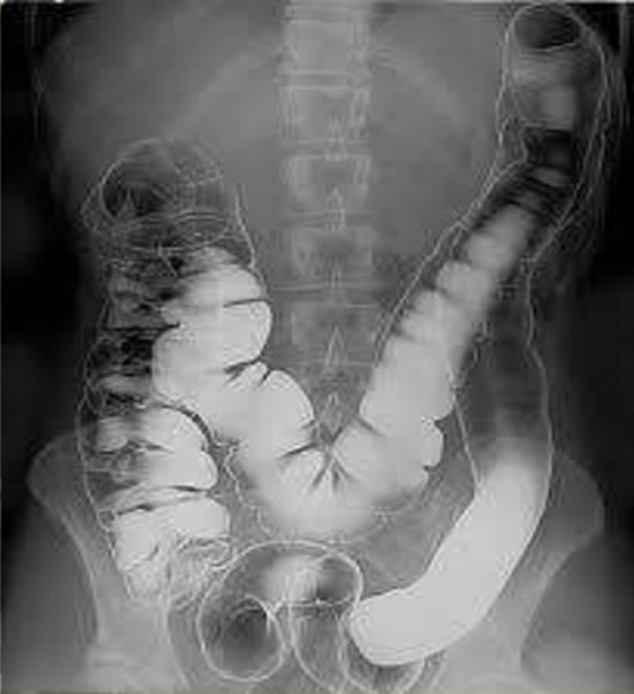
Large intestine
It measures 1.5 m in adult human

Slide 5
Functional abnormalities
CONSTIPATION
Definition:
Frequency of bowel movements of three or less in a week with the need to strain at quarter or more of all bowel movements.
1 megacolon:
a- Hirschsprung’s disease
b- non-Hirschsprung’s megarectum and megacolon
2 non-megacolon:
a- slow transit
b- normal transit
c- Pelvic floor dysfunction

Slide 6
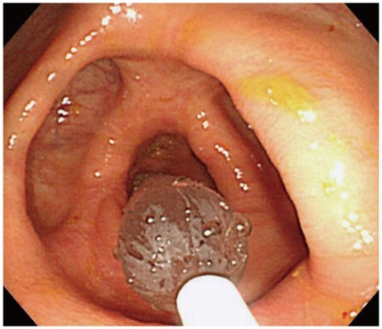
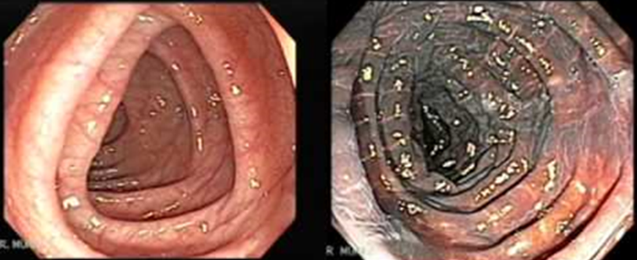
1-b Idiopathic megarectum and megacolon
Clinical features
Rare condition –
severe constipation.
faecal incontinence due to rectal faecal loading that requires manual evacuation.
abdominal distension and pain.
On clinical examination:
a hard faecal mass arising out of the pelvis
DRE - faecaloma in the lumen
Patulous anus, perianal soiling is common
Sigmoidoscopy is difficult
Melanosis coli, also pseudomelanosis coli, is a disorder of pigmentation of the wall of the colon. It is benign, and may have no significant correlation with disease.

Slide 7
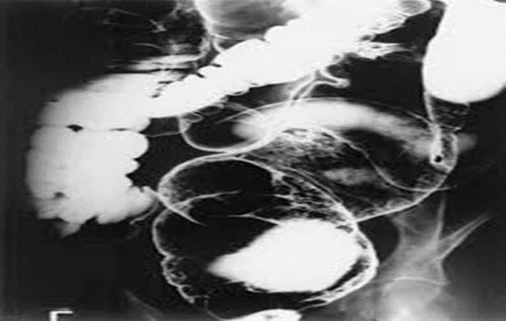
Imaging
Water-soluble contrast study
Anorectal physiology tests
Delayed ﬁrst sensation and raised maximum tolerated volume.
Full-thickness rectal biopsy.

Slide 8
Medical
directed at emptying the rectum and keeping it empty with enemas, washouts and sometimes manual evacuation under anaesthesia.
develop a regular daily bowel habit, with the use of osmotic laxatives to help the passage of semiformed stool. Rectal evacuation with suppositories
biofeedback therapy may be useful in resistant cases.
Surgical
1-resection of the dilated rectum and colon.
2-colectomy with the formation of an ileorectal anastomosis.
3-restorative proctocolectomy;
4-vertical reduction rectoplasty
5-Stoma formation

Slide 9
2-Non-megacolon constipation into the following three types:
Normal-transit constipation (NTC)
Slow-transit constipation (STC)
Pelvic floor dysfunction (ie, pelvic floor dyssynergia)
Secondary constipation
Dietary issues that may cause constipation include inadequate water intake; inadequate fiber intake; overuse of coffee, tea, or alcohol; a recent change in bowel habit paralleled by changes in the diet; and ignoring the urge to defecate. Reduced levels of exercise may play a role as well.
Structural causes of secondary constipation include anal fissures, thrombosed hemorrhoids, colonic strictures, obstructing tumors, volvulus.

Slide 10
Medications that may contribute to constipation include the following:
Antidepressants (eg, cyclic antidepressants and monoamine oxidase inhibitors [MAOIs])
Metals (eg, iron and bismuth)
Anticholinergics (eg, benztropine and trihexyphenidyl)
Opioids (eg, codeine and morphine)
Antacids eg, (aluminum and calcium compounds)
Calcium channel blockers (eg, verapamil)
Nonsteroidal anti-inflammatory drugs (NSAIDs; eg, ibuprofen and diclofenac)
Sympathomimetics (eg, pseudoephedrine)
Many psychotropic drugs
Cholestyramine and stimulant laxatives (long-term use) - Although laxatives are frequently used to treat constipation, chronic laxative use becomes habituating and may lead to the development of a dilated atonic laxative colon, which necessitates increasing laxative use with decreasing efficacy
Inadequate thyroid hormone supplementation
Constipation may be of toxicologic origin, as with lead poisoning.
Psychological issues (eg, depression, anxiety, somatization, and eating disorders) may also contribute to the development of constipation.

Slide 11
NTC
Most common subtype of primary constipation. Although the stool passes through the colon at a normal rate, patients find it difficult to evacuate their bowels. Patients in this category sometimes meet the criteria for IBS with constipation (IBS-C). The primary difference between chronic constipation and IBS-C is the prominence of abdominal pain or discomfort in IBS. Patients with NTC usually have a normal physical examination. increase.
Rx Increase their water consumption and physical activity
STC
Characterized by infrequent bowel movements, decreased urgency, or straining to defecate since childhood. It occurs more commonly in female patients. Patients with STC have impaired phasic colonic motor activity. They may demonstrate mild abdominal distention or palpable stool in the sigmoid colon. May or may not be able to empty the rectum
Rx Difficult to treat medically
Surgical------ total colectomy w ileorectal anastomosis
Pelvic floor dysfunction
Characterized by dysfunction of the pelvic floor or anal sphincter. Patients often report prolonged or excessive straining, a feeling of incomplete evacuation, or the use of perineal or vaginal pressure during defecation to allow the passage of stool, or they may report digital evacuation of stool.
Rx dietary and laxatives unsuccessful
Surgery last resort- defunctioning ileostomy or colostomy

Slide 12
Investigation
Defaecating poroctography.
Measurement of whole gut transit time
ay suddenly follow abdominal or pelvic surgery
asking the patient to stop all laxatives and take a capsule containing radio-opaque markers .
Retention of more than 80% of the shapes, 120 hours after ingestion, is abnormal.

Slide 13
VASCULAR ANOMALIES (ANGIODYSPLASIA)
Capillary or cavernous haemangiomas are a cause of haemorrhage from the colon at any age.
In the
DD of haemorrahage from colon
Diverticulosis,
Ulcerative colitis
Ischaemic colitis
Radiation colitis
Benign polyps
Malignant tumors
Clinical features
Associated with ageing, with ranges from 5 to 25% over the age of 60 years.
Angiodysplasias occur particularly in the ascending colon and caecum .
The malformations consist of dilated tortuous submucosal veins
In the majority, the symptoms are minor or anaemia.
There is no gender predilection.
About 10–15% can have brisk bleeds, which may present as melaena or hematochezia.

Slide 14
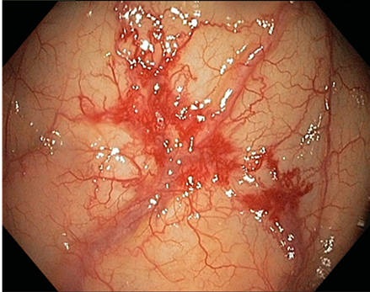
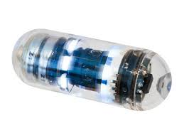
Investigation
Barium enema is usually unhelpful
colonoscopy may show the characteristic lesion in the right colon.
The lesions are only a few millimetres in size and appear
as reddish, raised areas at endoscopy.
‘Pill’ or “capsule ”endoscopy.
Selective superior and inferior mesenteric angiography shows the site and extent of the lesion by a blush.
Bleeding rate>0.5-1.0 ml/min
radioactive test using technetium-99m (99mTc)-labelled red cells
may conﬁrm and localise the source of haemorrhage.
Bleeding rate>0.1 ml/min
Treatment
The ﬁrst principle is to stabilise an unstable circulation.
the bleeding needs to be localised .
In severe uncontrolled bleeding, surgery becomes necessary.

Slide 15
BLIND LOOP SYNDROME
The blind loop syndrome is caused by stasis of the intestinal contents with subsequent bacterial overgrowth.
stricture, stenosis, fistula, diverticulum, or blind pouch.
The syndrome is characterized by steatorrhea, diarrhea, anemia, weight loss, abdominal pain, multiple vitamin deficiencies, joint pain and occasionally neurological disorders.
Treatment
surgical eradication of the cause of the stasis.

Slide 16
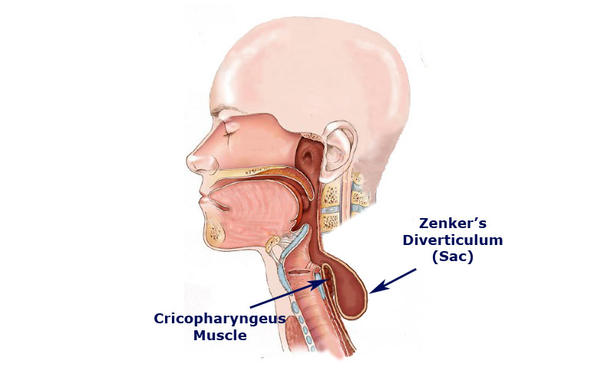
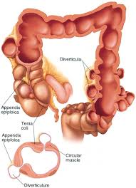
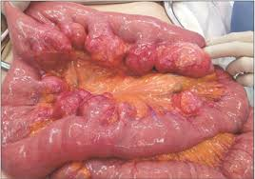
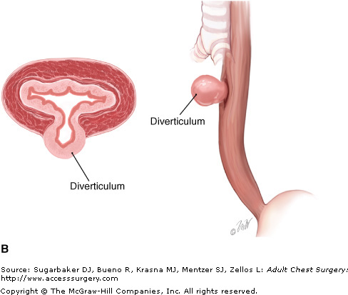
SMALL INTESTINAL AND COLONIC DIVERTICULAR DISEASE
Diverticulum: A bulging sac in any portion of the gastrointestinal tract

Slide 17
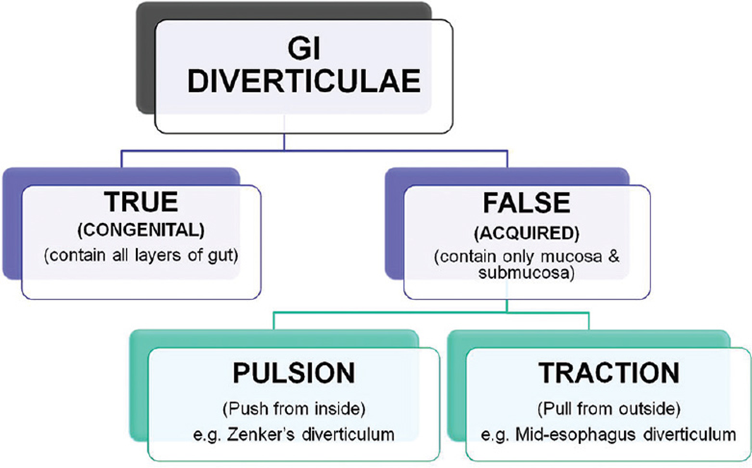
1- Congenital
All three coats of the bowel are present in the wall of the diverticulum, e.g. Meckel’s diverticulum.
2- Acquired
The wall of the diverticulum lacks a proper muscular coat. Most alimentary diverticula are thought to be acquired.

Slide 18
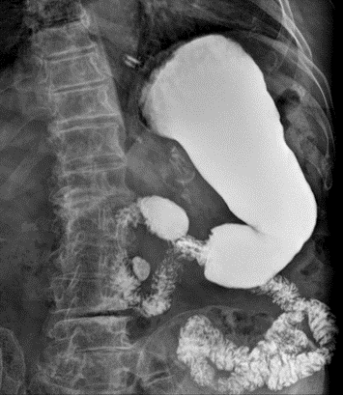
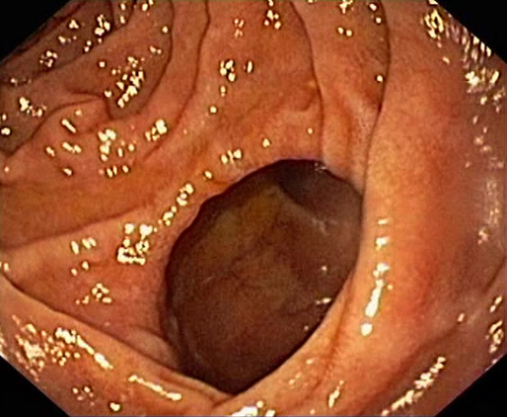
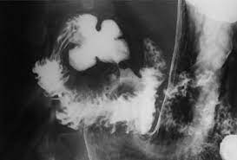
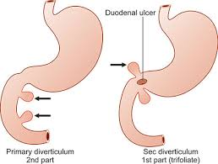
SMALL INTESTINAL DIVERTICULAR DISEASE
Duodenal diverticula

Slide 19
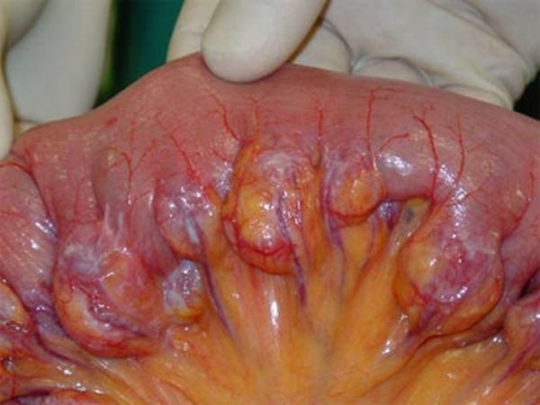
Jejunal diverticula
variable size and multiple
they may
(1) be symptomless
(2) give rise to abdominal pain
(3) produce a malabsorption syndrome
(4) present as an acute abdomen with acute inﬂammation and occasionally perforateperforation.
Treatment:
Resection with end-to-end anastomosis

Slide 20
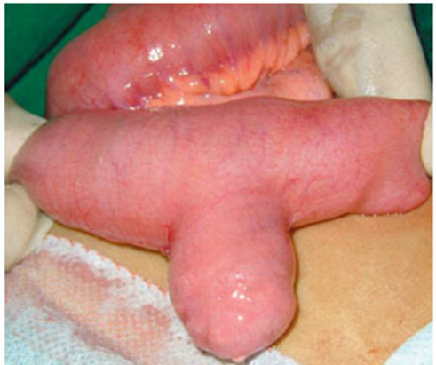
Meckel’s diverticulum
Meckel’s diverticulum is the most common congenital anomaly of the GI tract.
It represents the patent intestinal end of the vitellointestinal duct.
affecting approximately 2% of the population;
it is commonly 2 feet (60cm) from the ileocaecal valve,
It is 2 inches (3–5 cm) long.
2:1 female predominance.
one half of the those who are symptomatic are under 2 years of age)

Slide 21
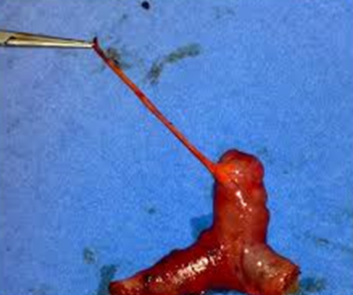
symptoms :
1-Severe haemorrhage
caused by peptic ulceration
2-Intestinal obstruction
Intussusception
Band extending between the diverticulum
and the base of the mesentery,
3-Meckel’s diverticulitis
4-Perforation
Progression of diverticulitis,
Ulceration of adjacent ileal mucosa
Secondary to ingested foreign body like fish bone, chicken bone
Traumatic

Slide 22
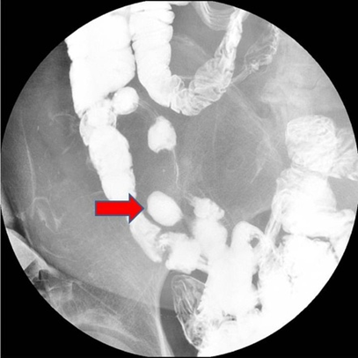
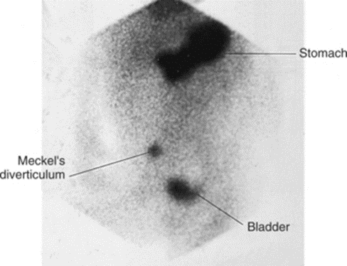
Imaging
small bowel enema would be the most accurate investigation.
Technetium -99m pertechnetate radioisotope scintigraphy
Angiography
Treatment
TREATMENT
Meckel’s diverticulectomy

Slide 23
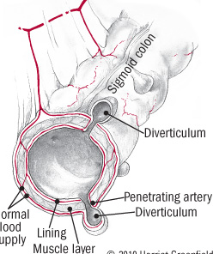
COLONIC DIVERTICULAR DISEASE
Diverticulosis refers to the presence of diverticula without inflammation.
Diverticulitis refers to inflammation and infection associated with diverticula.
The prevalence of diverticular disease in the western world is 60% over the age of 60 years.
The condition is found in the sigmoid colon in 90% of cases, but the caecum can also be involved.
The majority of colonic diverticula are false diverticula in which the mucosa and muscularis mucosa have herniated through the colonic wall .
They are thought to be pulsion diverticula resulting from high intraluminal pressure.
It is thought to be related to reduced ﬁbre in the western diet. This results in low stool
bulk with resulting segmentation and hypertrophy of the colonic wall musculature,
thus causing increased intraluminal pressure.
Diverticular disease is rare in Africans and Asians.

Slide 24
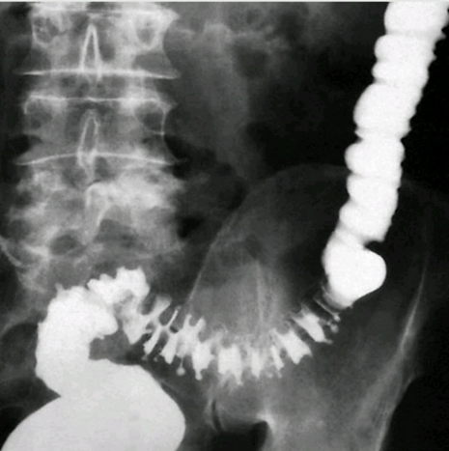
Diverticulosis
The sigmoid colon is the most common site of diverticulosis.
Diverticulosis is an acquired disorder.
Asymptomatic
the diverticulum consists of a protrusion of mucous membranes
covered with peritoneum. There is thickening of the circular
muscle ﬁbres of the intestine, which develops
concertina or saw-tooth appearance
on barium enema .

Slide 25
Diverticulitis
Diverticulitis is the result of inﬂammation of one or more diverticula, usually with some pericolitis
incidence 10 to 25% of people with diverticulosis
It is not a precancerous condition, but cancer may coexist. Diverticular disease and carcinoma coexist in 12% of cases
Clinical features
Elective or uncomplicated diverticulitis
In mild cases, symptoms such as distension, ﬂatulence and a sensation of heaviness in the lower abdomen may be indistinguishable from those of irritable bowel syndrome.
Emergency or complicated diverticulitis
left iliac fossa pain, with or without peritonitis.
Fever, malaise and leucocytosis can differentiate diverticulitis from painful diverticulosis. The patient may pass loose stools or may be constipated;
urinary symptoms may herald the formation of a vesicocolic ﬁstula, which leads to pneumaturia (ﬂatus in the urine) and even fecaluria (faeces in the urine).

Slide 26
Signs:
the lower abdomen is tender, especially on the left.
The sigmoid colon is often palpable, tender and thickened.
Rectal examination may, reveal a tender mass.

Slide 27
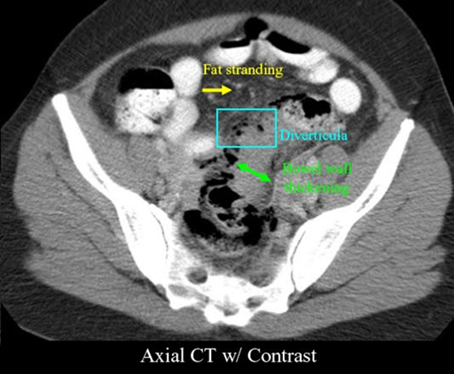
Diagnosis
Radiology
computerised tomography (CT). It is particularly good at identifying bowel wall thickening, abscess formation and extraluminal disease. The speciﬁcity is high and it is able to demonstrate other pathology.
Barium enemas and sigmoidoscopy.
Used in stable patient In the acute situation,
Watersoluble contrast enemas
large bowel obstruction.
Colonoscopy
Cystoscopy

Slide 28
Classiﬁcation of contamination
Hinchey Classiﬁcation of diverticulitis
Stage Severity Pain Systemic Investigation Management
1 Pericolic abscess LIF Possibly Delayed barium Bowel rest,IV Ab
or phlegmon no change enema,endoscopy DVT prophylaxis,
and fluids
severe,
2 Pelvic or intra- fullness Mild toxic CT PC drainage
abdominal abscess. in LIF
3 Nonfaceulent Peritonitis Toxic CT Resuscitation
Peritonitis +operation
4 Faeculent Peritonitis Severe toxicity, Proceed Resuscitation
peritonitis shock to operation +immediate operation

Slide 29
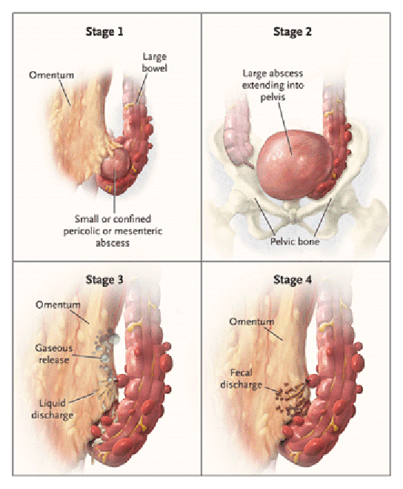

Slide 30
History
The original surgical Hinchey classification was developed in 1978, by E John Hinchey et al. , categorizing four stages of acute diverticulitis. In the 1980s, with the introduction of CT, some modifications were made to the original surgical classification system as a radiological staging system was required for the management of acute diverticulitis, leading to the most recent modification made by Kaiser et al in 2015.
According to Edward John Hinchey classification,
which of the following features describes stage II of an acute diverticulitis?
diverticulitis with generalized fecal peritonitis
diverticulitis with generalized purulent peritonitis
diverticulitis with pericolic or mesenteric abscess
diverticulitis with walled off pelvic abscess phlegmon

Slide 31
Management
Non-complicated Diverticulosis :
High-residue diet containing roughage (wholemeal bread, ﬂour, fruit and vegetables).
Bulk formers such as bran, Celevac, Isogel and Fybogel
Antispasmodics for painful diverticular disease
Most patients with uncomplicated diverticulitis will recover without surgery,
Risk of complications increases with recurrent disease.
Acute diverticulitis
treated by bed rest and intravenous antibiotics (usually cefuroxime and metronidazole).

Slide 33
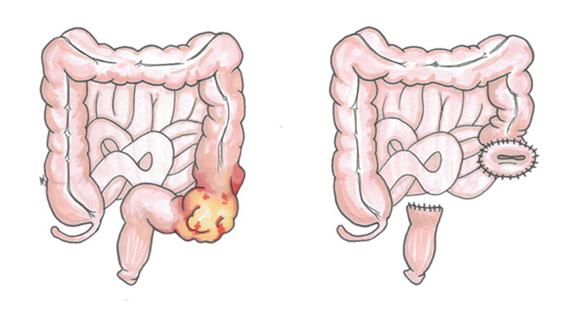
Operative procedures for diverticular disease
1- The ideal operation carried out as an interval procedure after careful preparation of the gut is a one-stage resection.
2- If there is obstruction, inﬂammatory oedema and
adhesions or the bowel is loaded with faeces,
Hartmann’s operation is the procedure of choice
3- In acute perforation, peritonitis soon becomes general
and may be purulent, with a mortality rate of about 15%.
Gross faecal peritonitis carries a mortality rate of > 50%
A- primary resection and Hartmann’s procedure
B- primary resection and anastomosis after on-table lavage in selected cases;
C- exteriorisation of the affected bowel
4-Fistulae can be cured only by resection of the diseased bowel and closure of the ﬁstula.
5- Haemorrhage from diverticulitis must be distinguished from angiodysplasia. On-table lavage and colonoscopy may be necessary to localise the bleeding site. If the source cannot be located, then subtotal colectomy and ileostomy is the safest

Slide 34
Conclusions
Causes of constipation
Some conditions results in lower GIT bleeding.
Some causes of abdominal pain and acute abdomen.
steatorrhea, diarrhea, anemia, weight loss.

